Slide 2
Recall: Iteration
1. Initialize the “base” case of no iterations
2. Starting value
def sum_of_squares(n):
accum = 0
for i in range(1,n+1):
accum = accum + i*i
return accum
3. Ending value
4. New loop variable value

Slide 3
Recursion Key concepts – by example
1. Test for simple “base” case
2. Solution in simple “base” case
def sum_of_squares(n):
if n < 1:
return 0
else:
return sum_of_squares(n-1) + n**2
3. Assume recusive solution to simpler problem
4. Transform soln of simpler problem into full soln

Slide 4
In words
The sum of no numbers is zero
The sum of 1² through n² is the
sum of 1² through (n-1)²
plus n²
def sum_of_squares(n):
if n < 1:
return 0
else:
return sum_of_squares(n-1) + n**2

Slide 5
Why does it work
sum_of_squares(3)
# sum_of_squares(3) => sum_of_squares(2) + 3**2
# => sum_of_squares(1) + 2**2 + 3**2
# => sum_of_squares(0) + 1**2 + 2**2 + 3**2
# => 0 + 1**2 + 2**2 + 3**2 = 14

Slide 6
How does it work?
Each recursive call gets its own local variables
Just like any other function call
Computes its result (possibly using additional calls)
Just like any other function call
Returns its result and returns control to its caller
Just like any other function call
The function that is called happens to be itself
Called on a simpler problem
Eventually bottoms out on the simple base case
Reason about correctness “by induction”
Solve a base case
Assuming a solution to a smaller problem, extend it

Slide 7
Questions
In what order do we sum the squares ?
How does this compare to iterative approach ?
def sum_of_squares(n):
accum = 0
for i in range(1,n+1):
accum = accum + i*i
return accum
def sum_of_squares(n):
if n < 1:
return 0
else:
return sum_of_squares(n-1) + n**2
def sum_of_squares(n):
if n < 1:
return 0
else:
return n**2 + sum_of_squares(n-1)

Slide 8
Tail Recursion
All the work happens on the way down the recursion
On the way back up, just return
def sum_up_squares(i, n, accum):
"""Sum the squares from i to n in incr. order"""
if i > n:
return accum
else:
return sum_up_squares(i+1, n, accum + i**2)
>>> sum_up_squares(1,3,0)
14
Base Case
Tail Recursive Case

Slide 9
Local variables
def sum_of_squares(n):
n_squared = n**2
if n < 1:
return 0
else:
return n_squared + sum_of_squares(n-1)
Each call has its own “frame” of local variables
What about globals?
https://goo.gl/CiFaUJ

Slide 10
Iteration vs Recursion
For loop:
def sum(n):
s=0
for i in range(0,n+1):
s=s+i
return s

Slide 11
Iteration vs Recursion
Recursion:
def sum(n):
if n==0:
return 0
return n+sum(n-1)

Slide 12
Fibonacci Sequence
fibonacci(n) = fibonacci(n-1) + fibonacci(n-2)
where fibonacci(1) == fibonacci(0) == 1

Slide 13
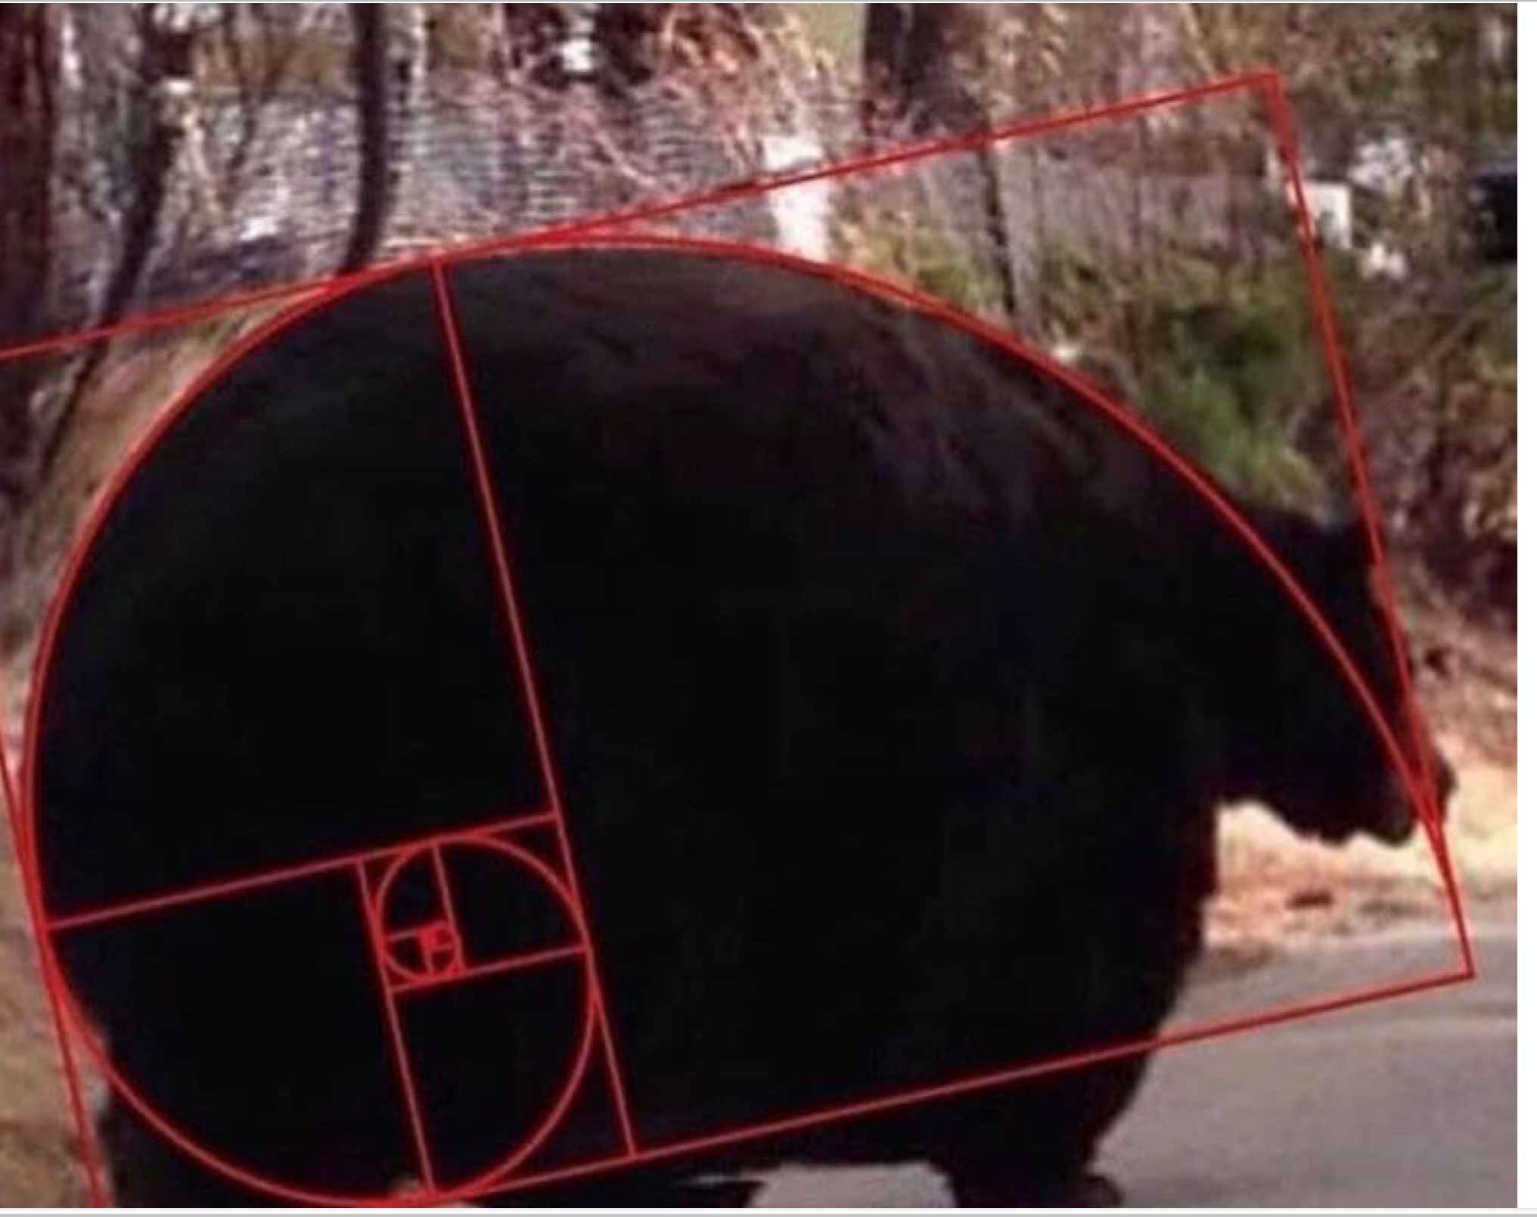
Go Bears!

Slide 14
Another Example
indexing an element of a sequence
def first(s):
"""Return the first element in a sequence."""
return s[0]
def rest(s):
"""Return all elements in a sequence after the first"""
return s[1:]
def min_r(s):
“””Return minimum value in a sequence.”””
if len(s) == 1:
return first(s)
else:
return min(first(s), min_r(rest(s)))
Slicing a sequence of elements
Base Case
Recursive Case
Recursion over sequence length, rather than number magnitude

Slide 15
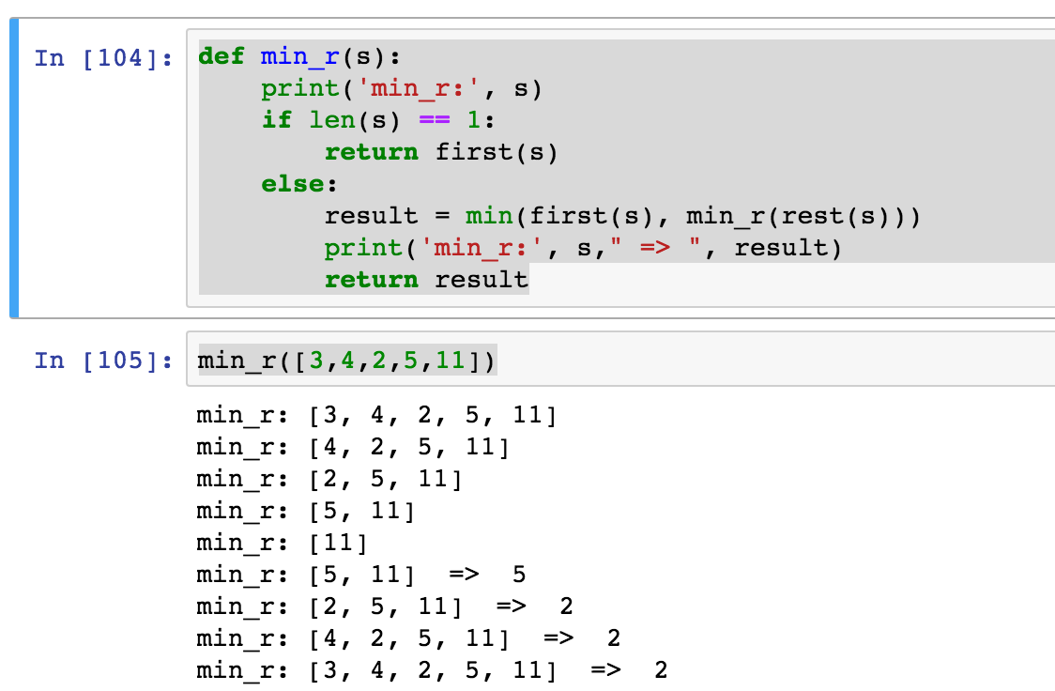
Visualize its behavior (print)
What about sum?
Don’t confuse print with return value

Slide 16
Trust …
The recursive “leap of faith” works as long as we hit the base case eventually
What happens if we don’t?

Slide 17

Recursion (unwanted)

Slide 18
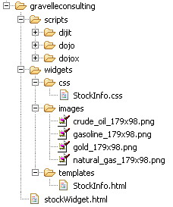
Example I
List all items on your hard disk
Files
Folders contain
Files
Folders
Recursion!

Slide 19
List Files in Python
def listfiles(directory):
content = [os.path.join(directory, x) for x in os.listdir(directory)]
dirs = sorted([x for x in content if os.path.isdir(x)])
files = sorted([x for x in content if os.path.isfile(x)])
for d in dirs:
print d
listfiles(d)
for f in files:
print f
Iterative version about twice as much code and much harder to think about.

Slide 20
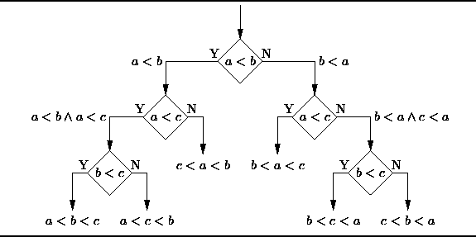
Example II
Sort the numbers in a list.
Hidden recursive structure: Decision tree!

